Slide 1
Cybersecurity discipline?
Notes:
Armco Steel
UC hire

Slide 2
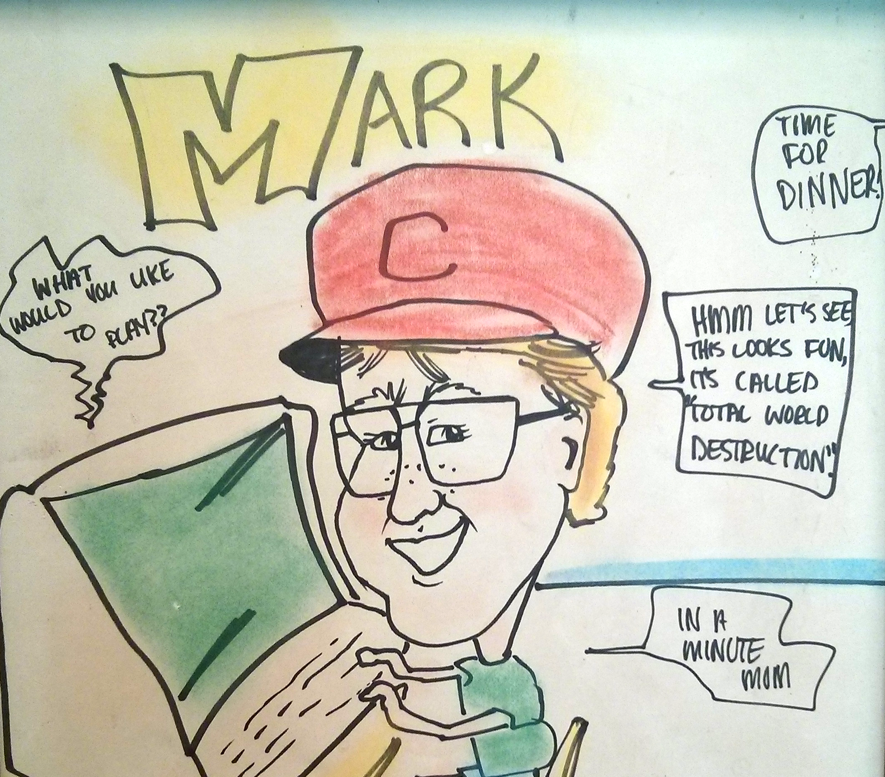
Kings Island, 1983
Notes:
30 Years ago
A few years later, coop student at DoD

Slide 3
“Cyber security requires a multi-disciplinary approach. Efforts should be made to educate and partner with disciplines not always thought of as related to cyber security.”
“Curative-not palliative-approaches are needed to address causes rather than symptoms of the continuing security breaches in computer systems.”
Hoffman, L. 2010. GW Cyber Security Research and Policy Institute Report.

Slide 4
Notes:
Before get into workforce, a pitch about my research
Embedded with criminologists
Hundreds of years of vetted theories for crime and prevention
Evidence-based rather than just heuristics

Slide 5
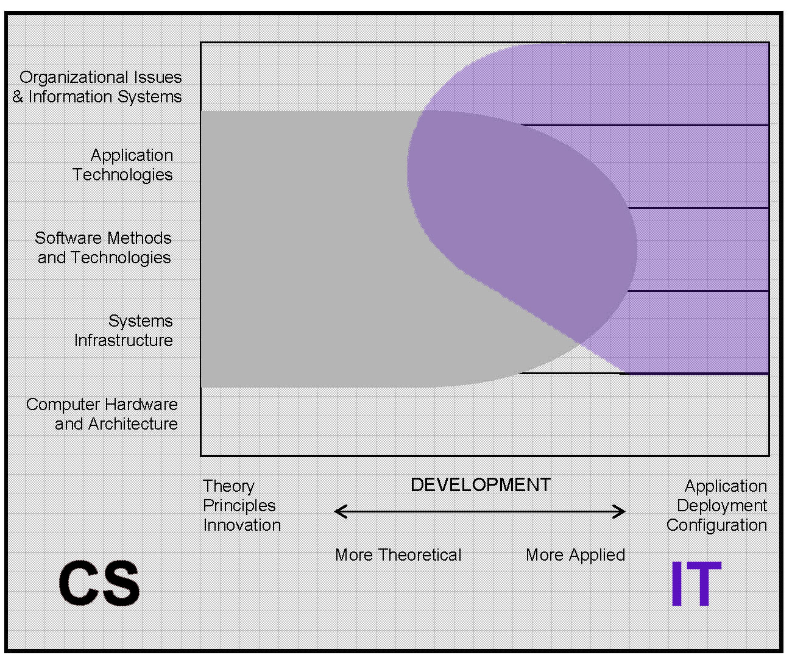
JTFCC (2005) “The Overview Report”, Joint Task Force for Computing Curricula, ACM
Notes:
Progression of IT discipline, CS ignored need of applied computing
ACM Curriculum Guidelines
Accreditation

Slide 6
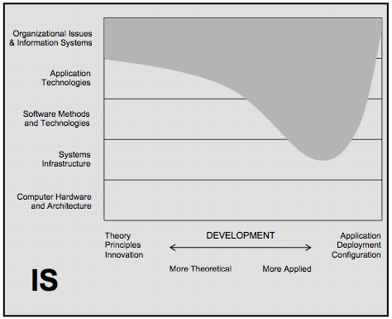
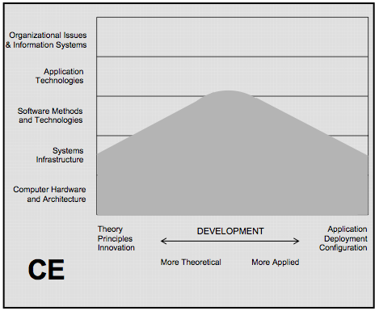
JTFCC (2005) “The Overview Report”, Joint Task Force for Computing Curricula, ACM

Slide 7
IS - Why do we need it?
CS/CE - How do we make it?
IT - How do we make it work?
Notes:
Cyber? Hiring folks for these jobs.

Slide 8
Industry v. Ubiquity

Slide 9
CYBER?
JTFCC (2005) “The Overview Report”, Joint Task Force for Computing Curricula, ACM
Notes:
Everywhere
Industry specific and growing ubiquity
Includes non-computing to tackle people and process (law, CJ, POLS, Business, Psychology) – interdisciplinary actually a good thing
Runs contrary to goals of other computing/business (increase revenue, decrease costs)

Slide 10
Notes:
My notion of needing ninjas
CS ignoring security (Cloudpassage – none of top 10 require, 3 have no classes, 2 of top 50 require – mich/BYU)
Strategic v. Tactical
New industry/jobs

Slide 11
Joint Task Force on Cybersecurity Education, 2017 (ACM, IEEE-CD, AIS SIGSEC, IFIP WG 11.8)

Slide 12
Cybersecurity Defined -
“A computing-based discipline involving technology, people, information, and processes to enable assured operations in the context of adversaries. ”
Joint Task Force on Cybersecurity Education, 2017 (ACM, IEEE-CD, AIS SIGSEC, IFIP WG 11.8)
Notes:
ADVERSARIES - HACKER DOG

Slide 13
Notes:
Good working document – find job titles and duties

Slide 14
“The National Cybersecurity Workforce Framework”, National Initiative for Cybersecurity Education (NICE), NIST

Slide 16
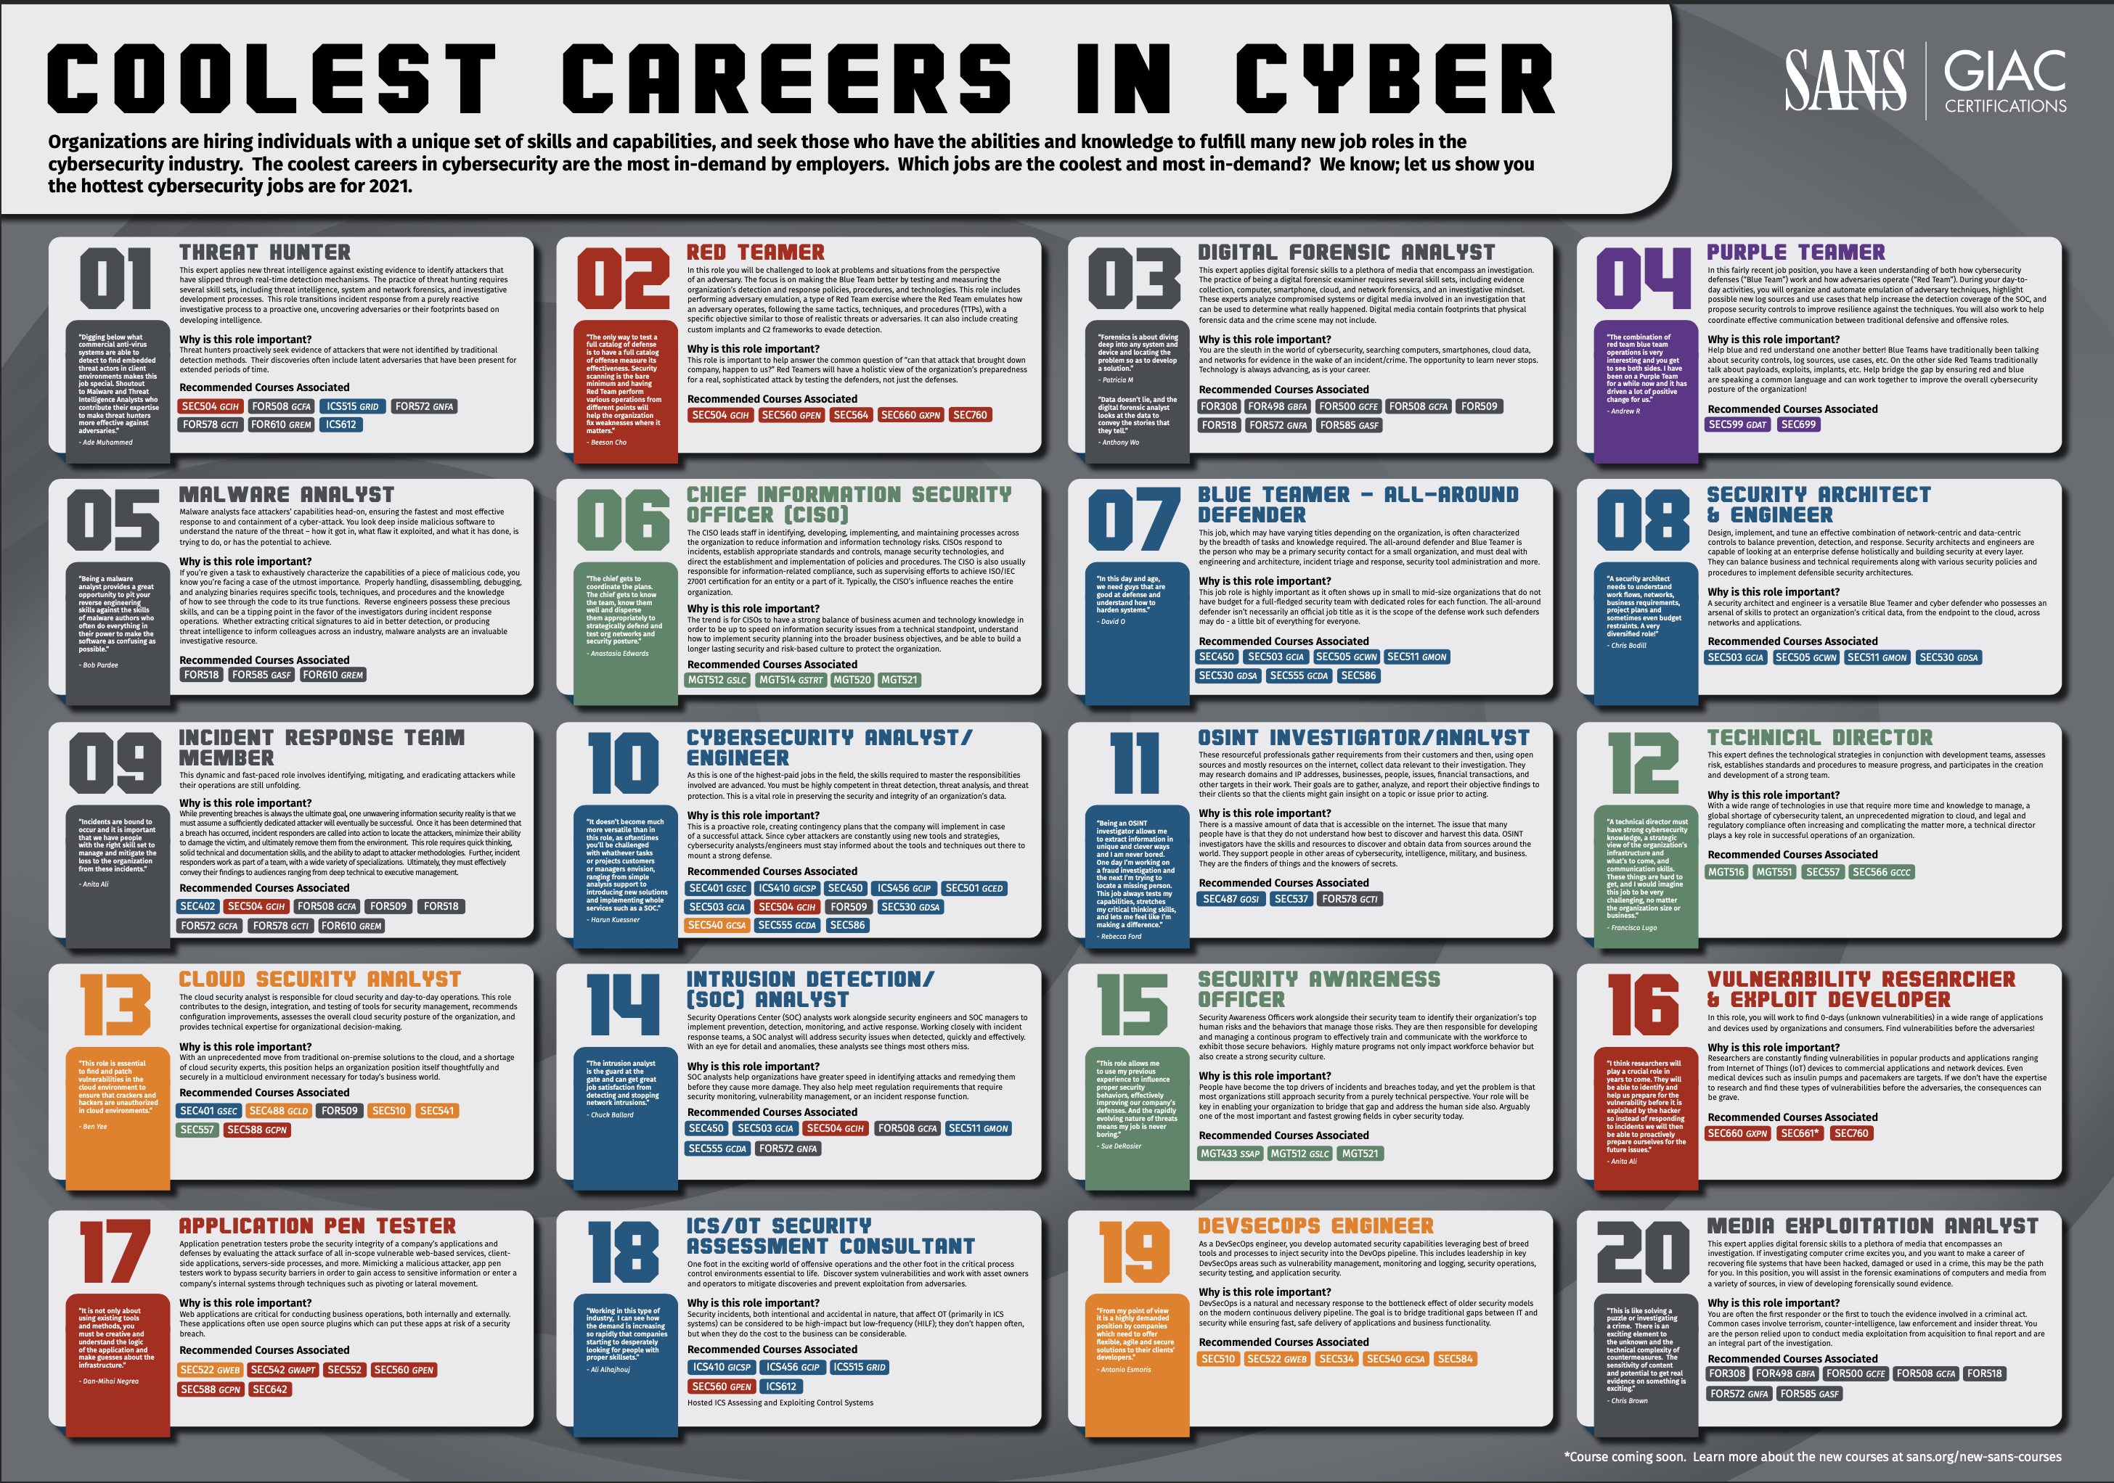

Slide 17
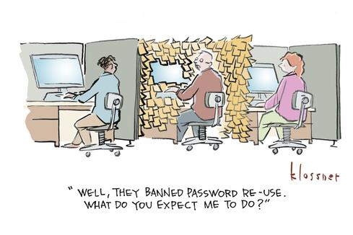
Adversary Goals?
PII
Credit Cards
IP (Intellectual Property)
Passwords
Ransom ($, Behavior)
Physical Damage
Geopolitics/Elections
Hacktivism/Leaked Info
Compute Power (DOS, Botnet)

Slide 18
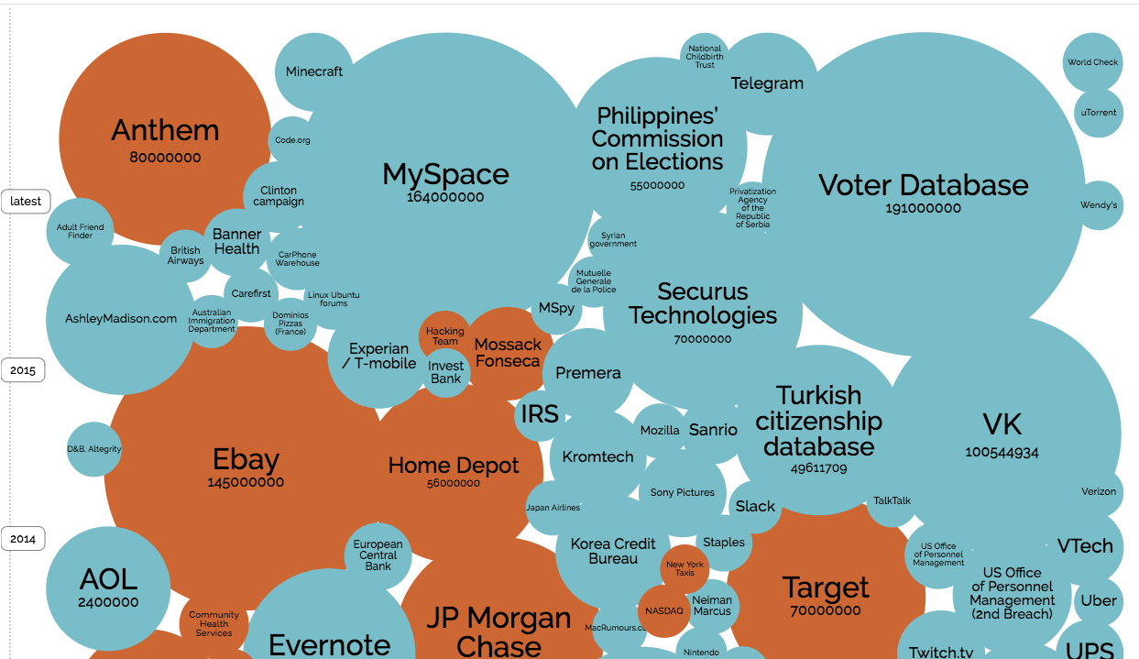
Data Breaches- bit.ly/breach-vis
http://www.informationisbeautiful.net/visualizations/worlds-biggest-data-breaches-hacks/
Notes:
How big is the problem?

